Slide 1
Mental Health Matters
Brianna Koch, MA, LCPC
Director of Counseling Services
Olivet Nazarene University Counseling Center

Slide 2
Helpful Steps…
Normalize the need for help
Validate, Acknowledge, Respond
Embed well-being in courses/discussions
Practice self-care and seek resources when needed

Slide 3
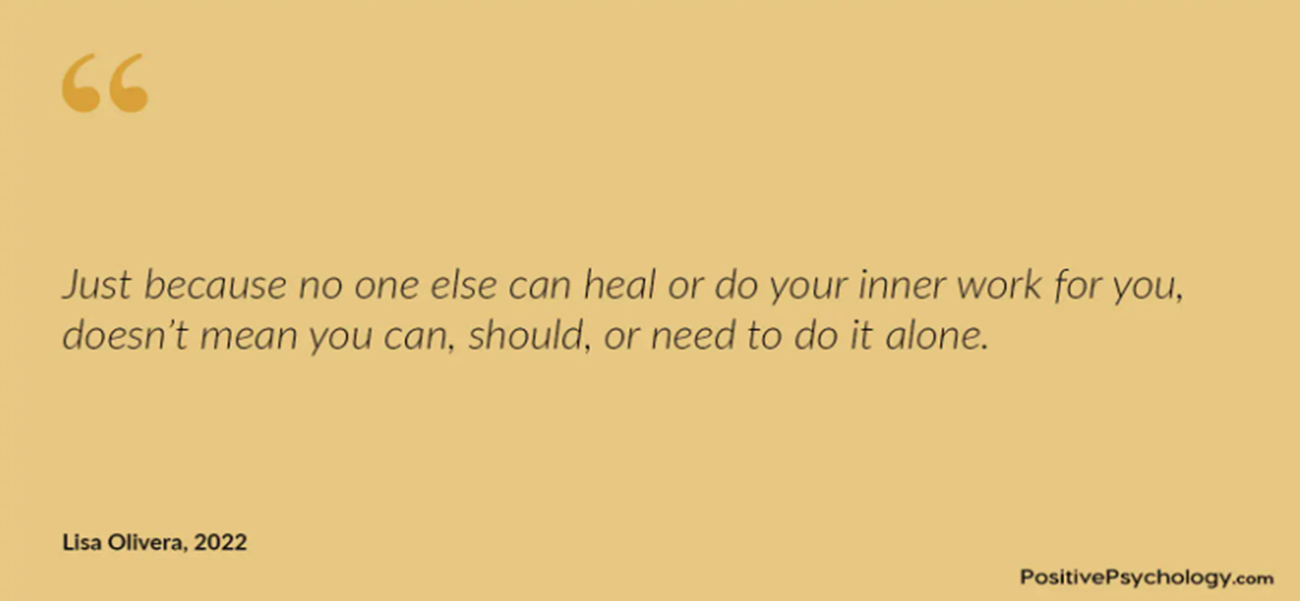

Slide 4
Mental Health Affects EVERYONE!
Adjustment Disorders to Schizophrenia
Your neighbor, yourself, your children, etc.
Bible to now
Listen without fixing

Slide 5
Signs of Struggle:
Disengaged
Isolated from others
Irritability
Disheveled Appearance
Tearful
Nervous
Appearing tired/falling asleep
Distressed/Unusual communication
Lack of communication
Won’t cooperate with group members
Unusual behavior

Slide 6
Validate Acknowledge Respond
V- Witness & Value
A- “I hear you”
R- Encourage, Resource, Follow up

Slide 7
Assess for crisis:
May become a crisis:
Panic Attack
Aggressive behavior
Substance misuse
Following a traumatic event
Non-suicidal self injury
Immediate Crisis:
Medical emergency
Suicidal thoughts and behaviors
Severe effects of alcohol or drug use
Severe psychotic states

Slide 8
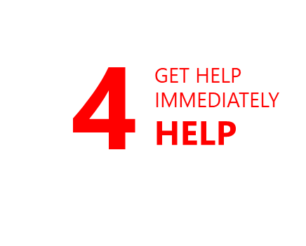
Suicide Risk Assessment

Slide 9
Crisis: Your Role
During a crisis, your role is to:
Try to work to keep the person and others safe for now. If you can’t, get help immediately.
Bring another opinion in!
De-escalate the situation and connect the individual to appropriate professional help.
Ways to de-escalate include: speak slowly and confidently, do not argue, do not threaten, do not raise your voice, use positive words, stay calm, do not restrict the person’s movement, take breaks in the conversation if needed

Slide 10
Ways to embed well-being…
Acknowledge stress
Acknowledge resources
Check in with students individually
Check in with students in groups
“Begin peacefully”…1-2 breaths, moment of quiet, devices put away, prayer, etc.
Clarify ways to communicate
Allow opportunities for students to connect with others
Emphasize effort
Affirm effort
Change the pace sometimes
Incorporate activities that focus on mental health

Slide 11
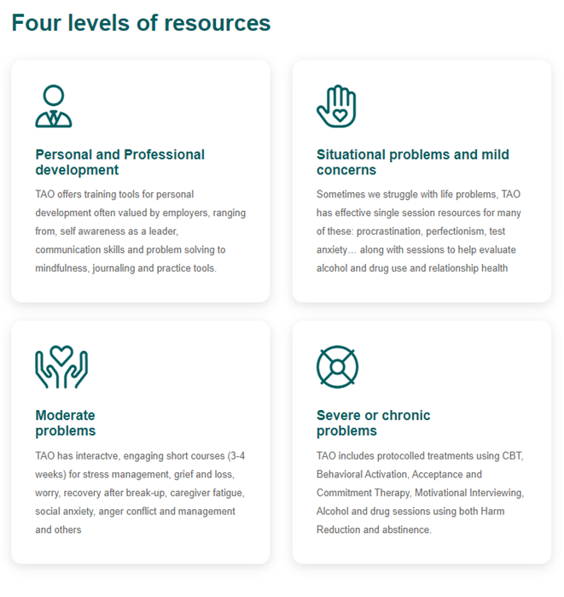
Care for yourself, too.
TAO
Reach Out
Wellness for you
Locate a therapist on psychologytoday.com
Open up about your need for more support
Seek local group support: Celebrate Recovery, Clove Alliance, and Bible Studies
National Resources: Emotions Anonymous, Crisis hotline/textline
Minimize things that drain your energy
Say “no” to good things to pursue the most important
Close your door or go offline sometimes
Incorporate actual breaks into your day (your boss may hate me for saying that ☺ )
There are different types of coping: unhealthy, healthy, and super helpful

Slide 12
Questions?

